Slide 1


Slide 2
PHP Laravel | Python Django
Advanced HTML
Advanced CSS
Intermediate JavaScript
Intermediate Bootstrap 5
Basic sass
MySQL, SQL,
PHP , Laravel
Git & GitHub
4 Real Time Project
Advanced HTML
Advanced CSS
Intermediate JavaScript
Intermediate Bootstrap 5
Basic sass
MySQL, SQL,
Python , Django
Git & GitHub
4 Real Time Project

Slide 3
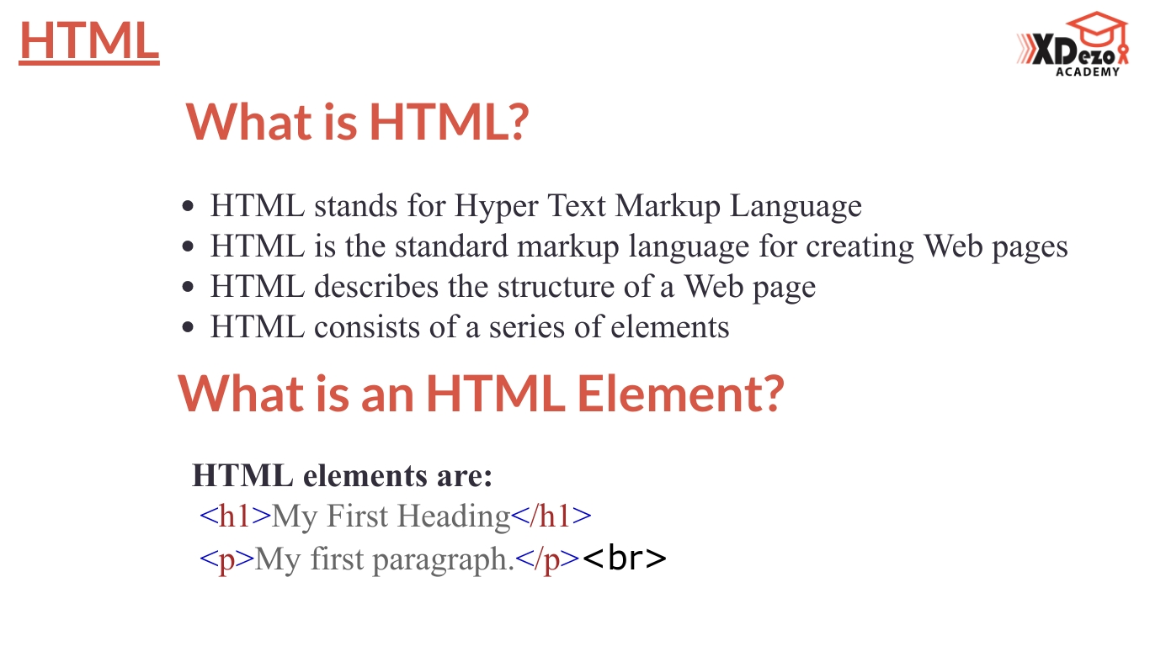

Slide 4
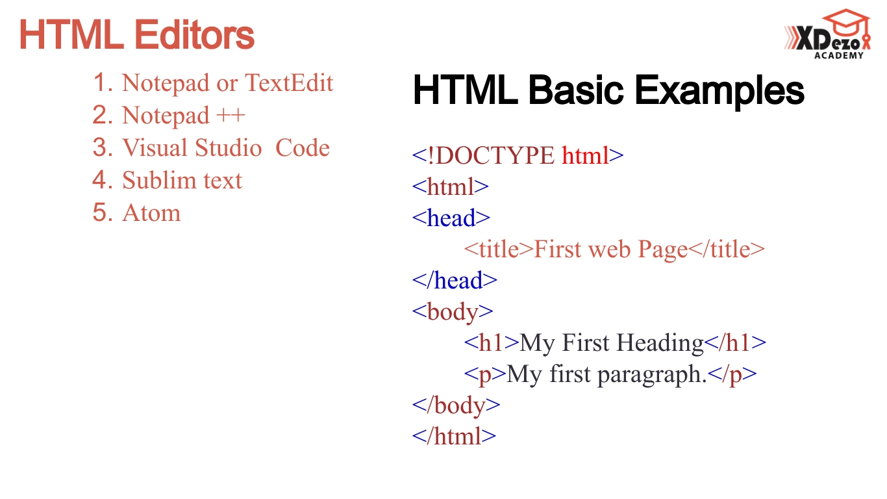

Slide 5
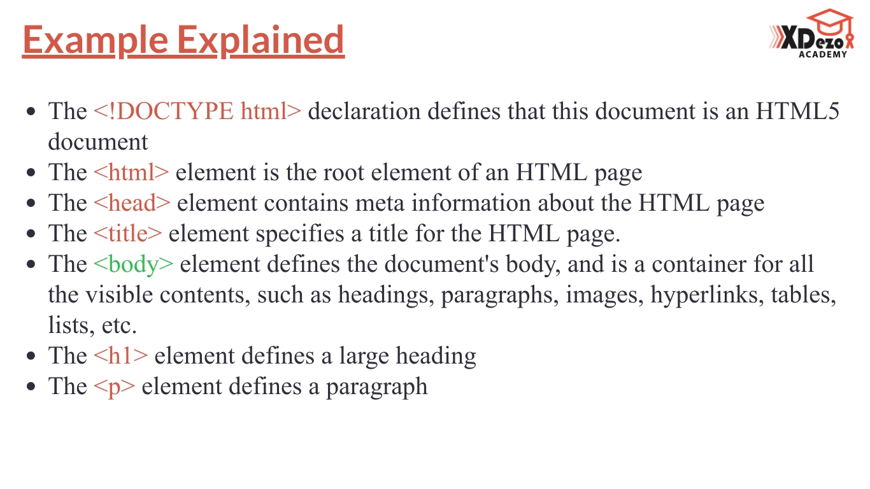

Slide 6
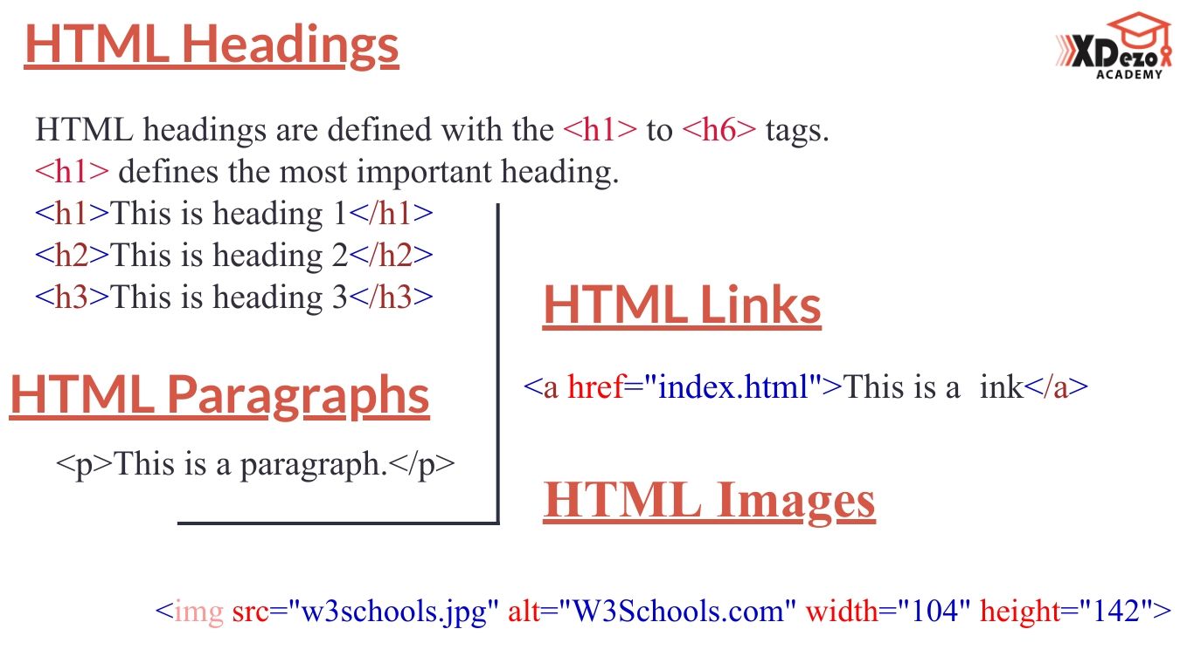

Slide 7
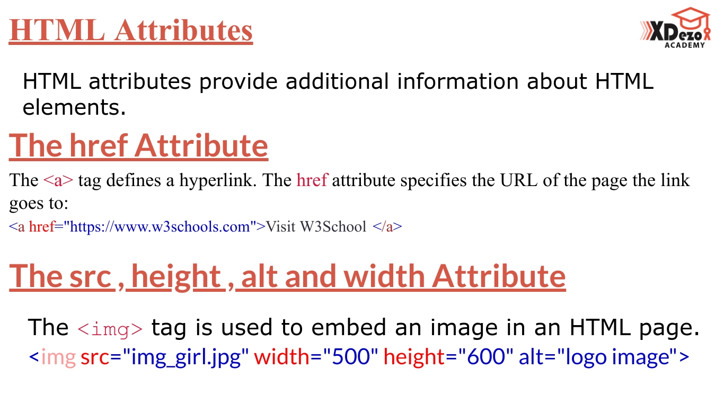

Slide 8
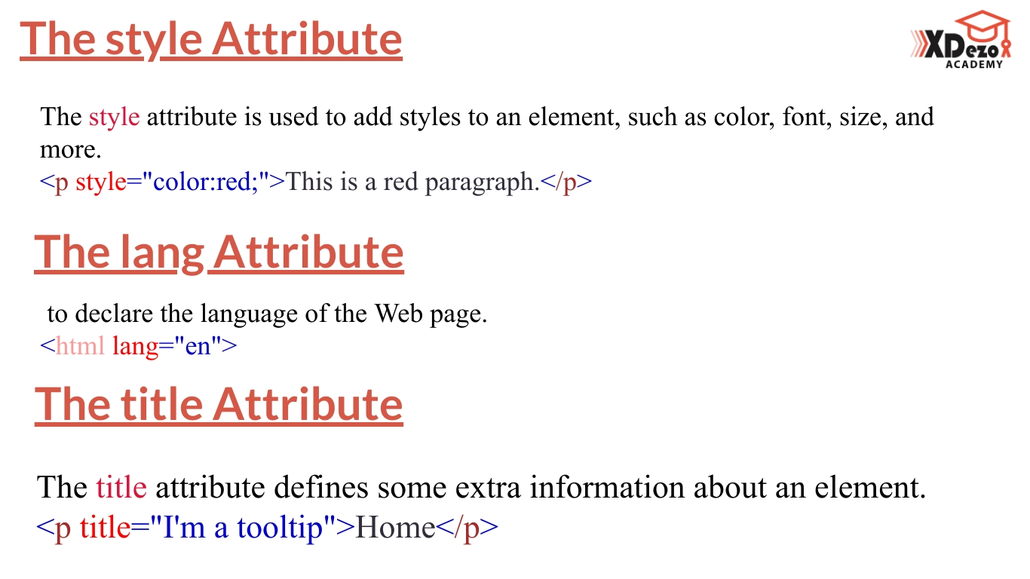

Slide 9
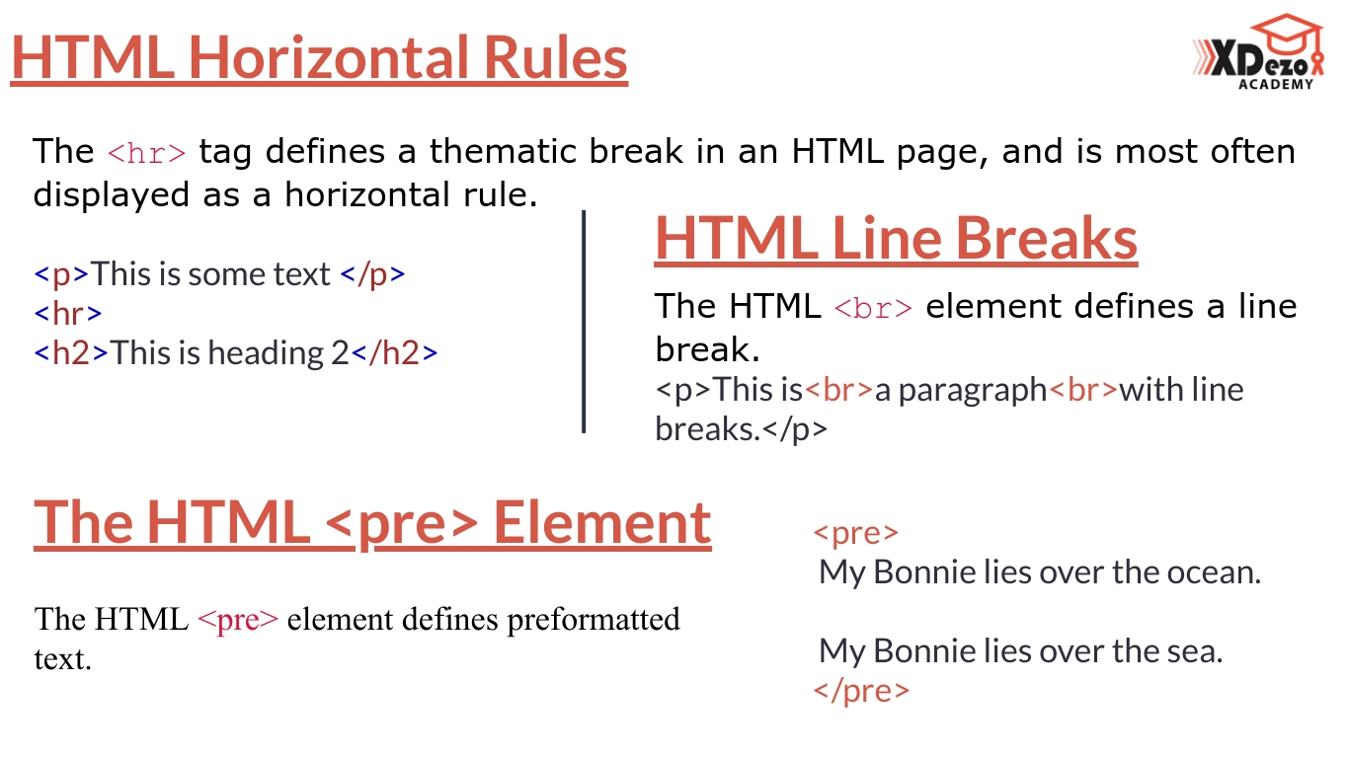

Slide 10
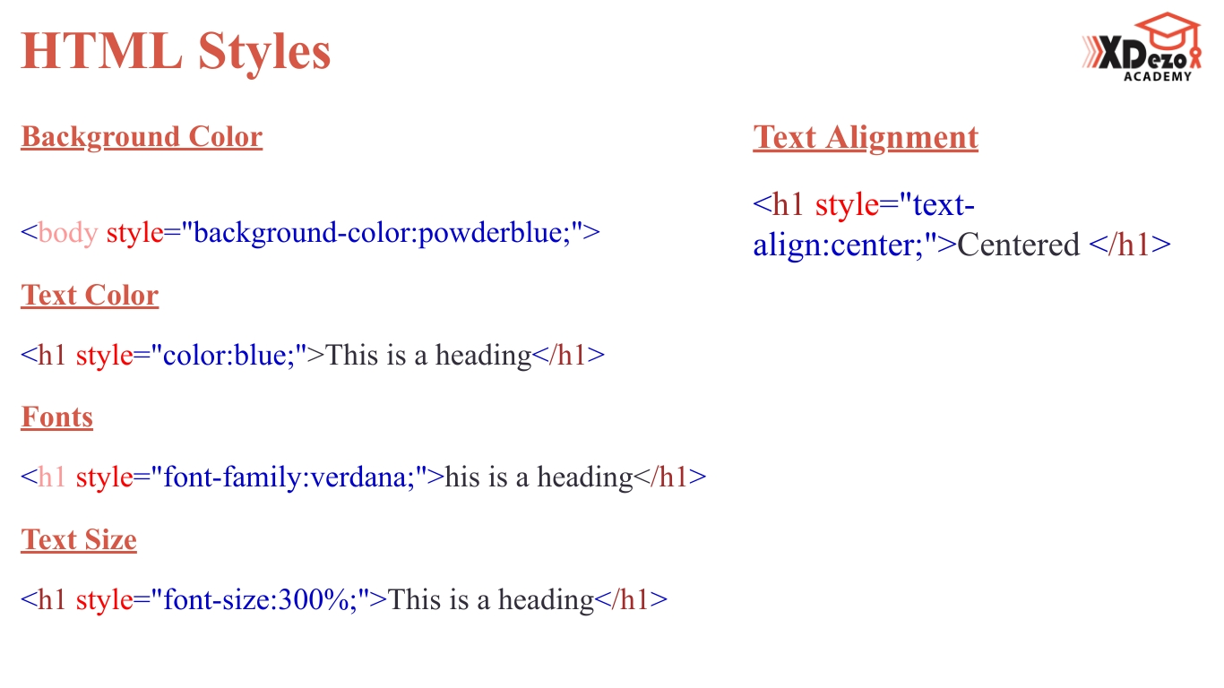

Slide 11
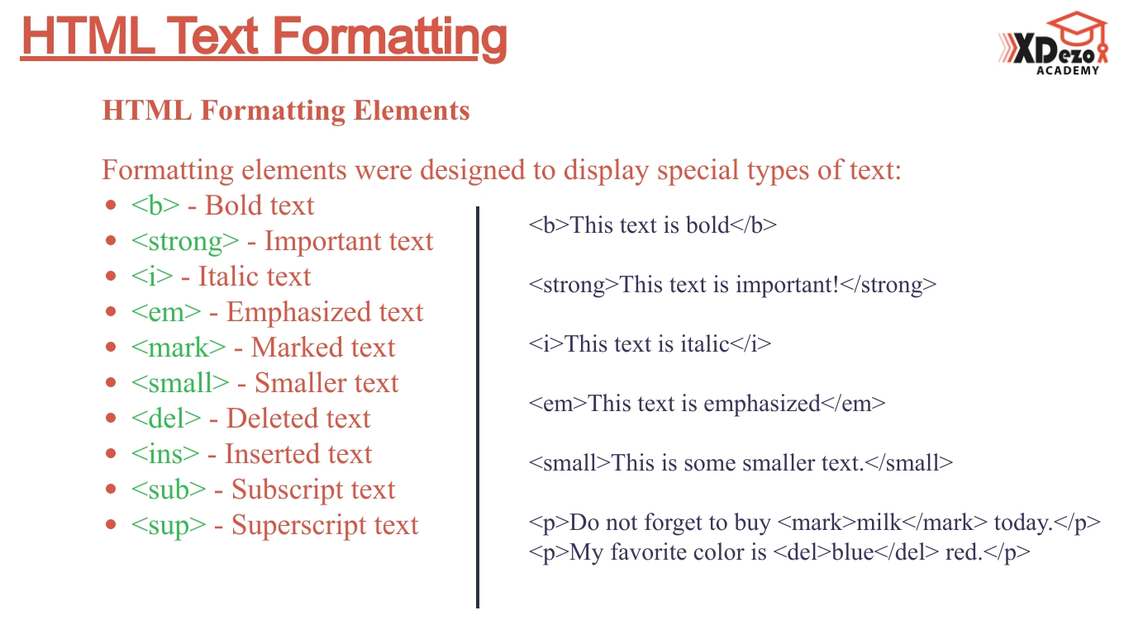

Slide 12
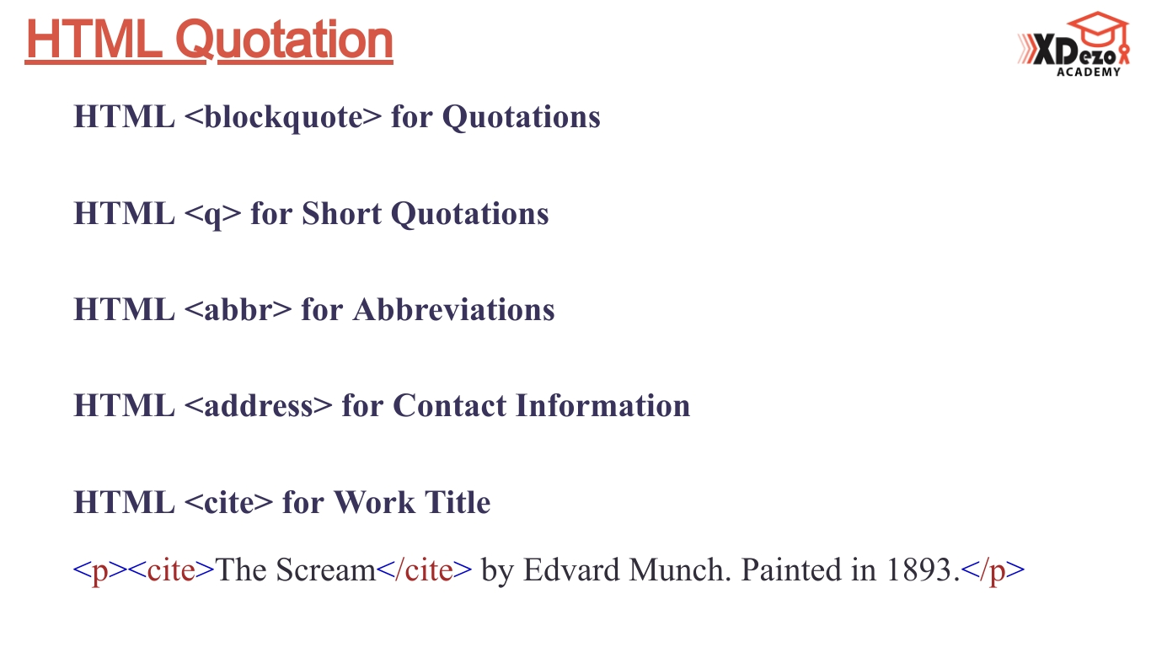

Slide 13
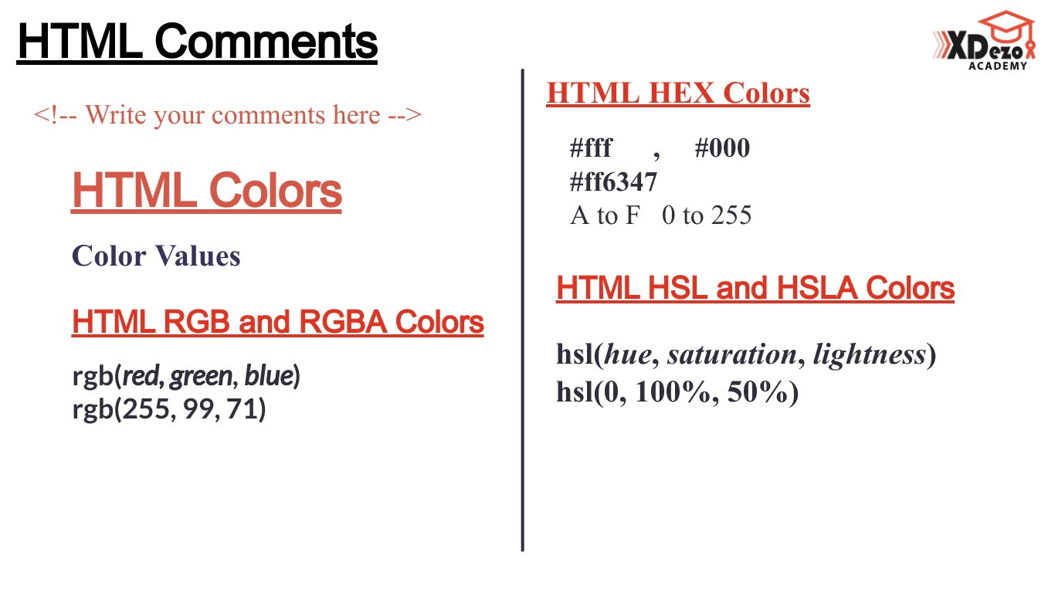

Slide 14
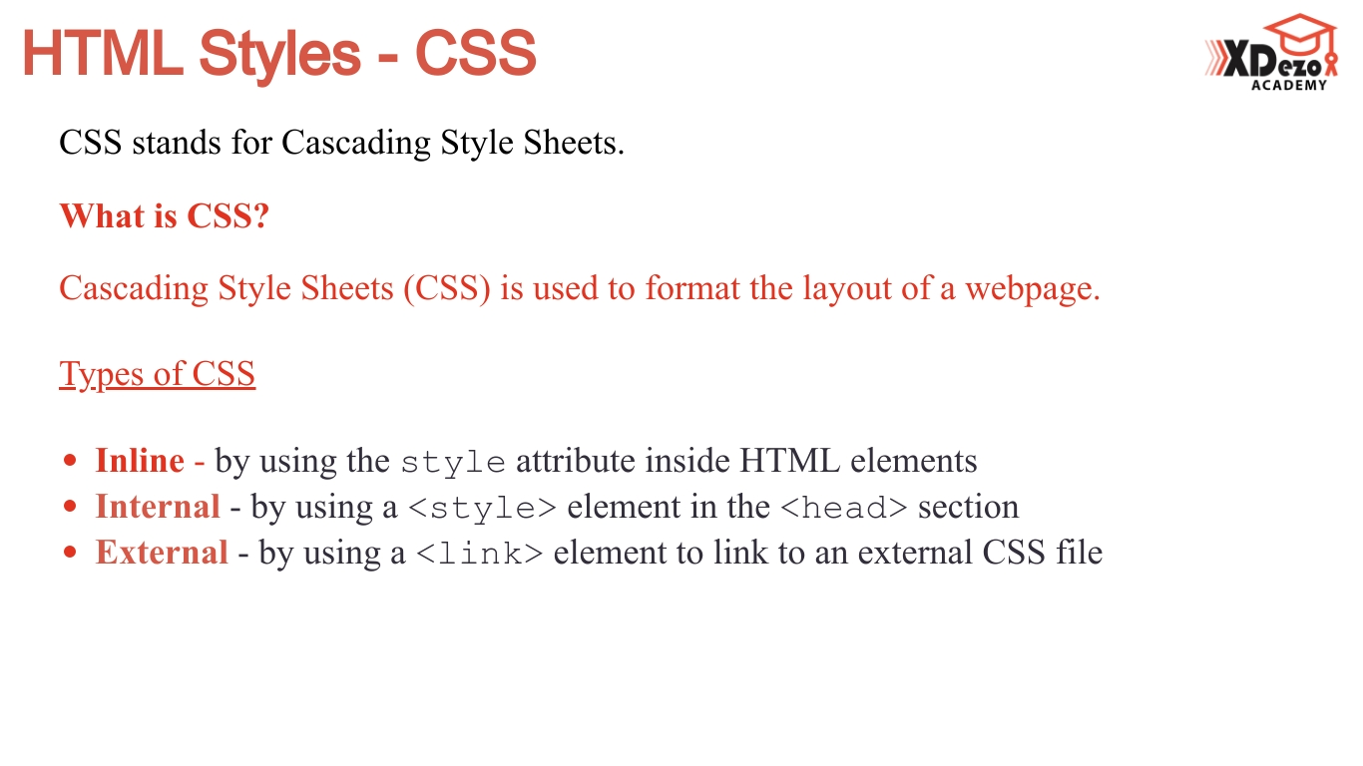

Slide 15
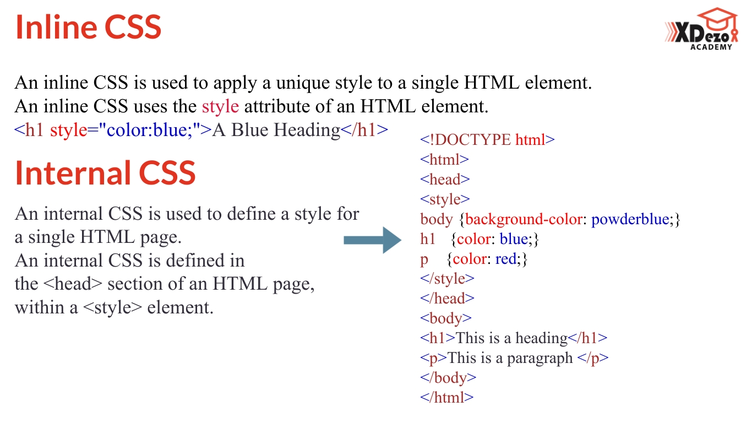

Slide 16
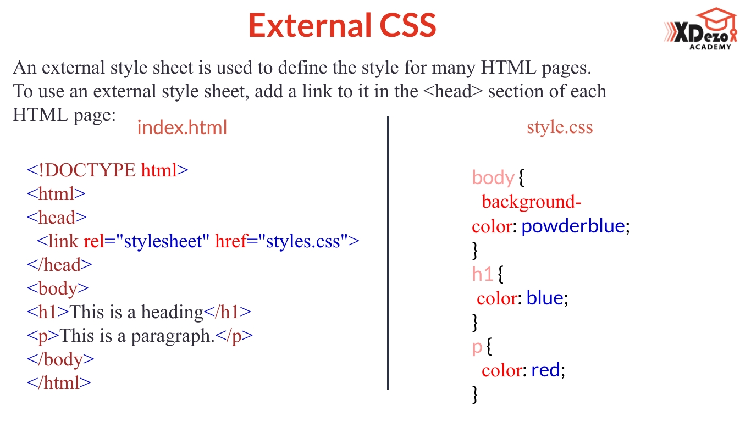

Slide 17
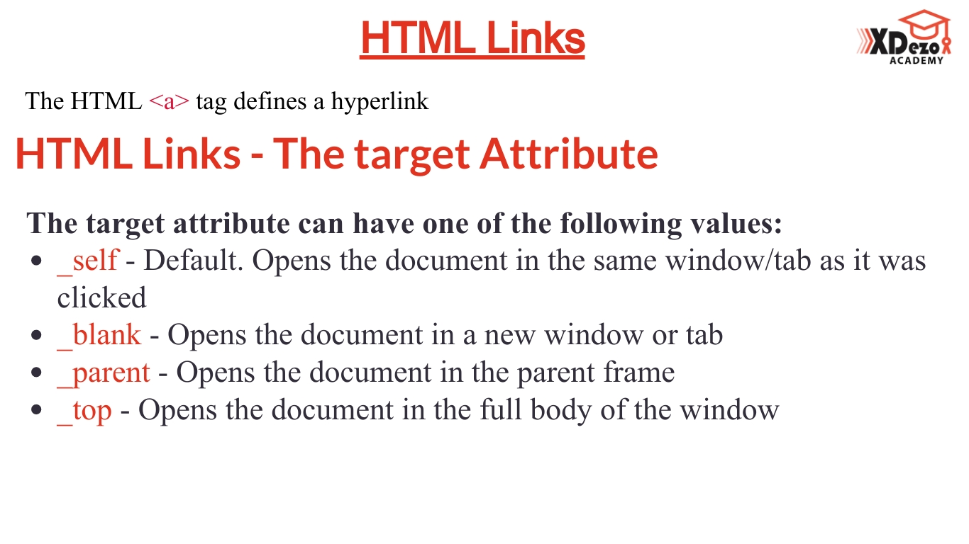

Slide 18
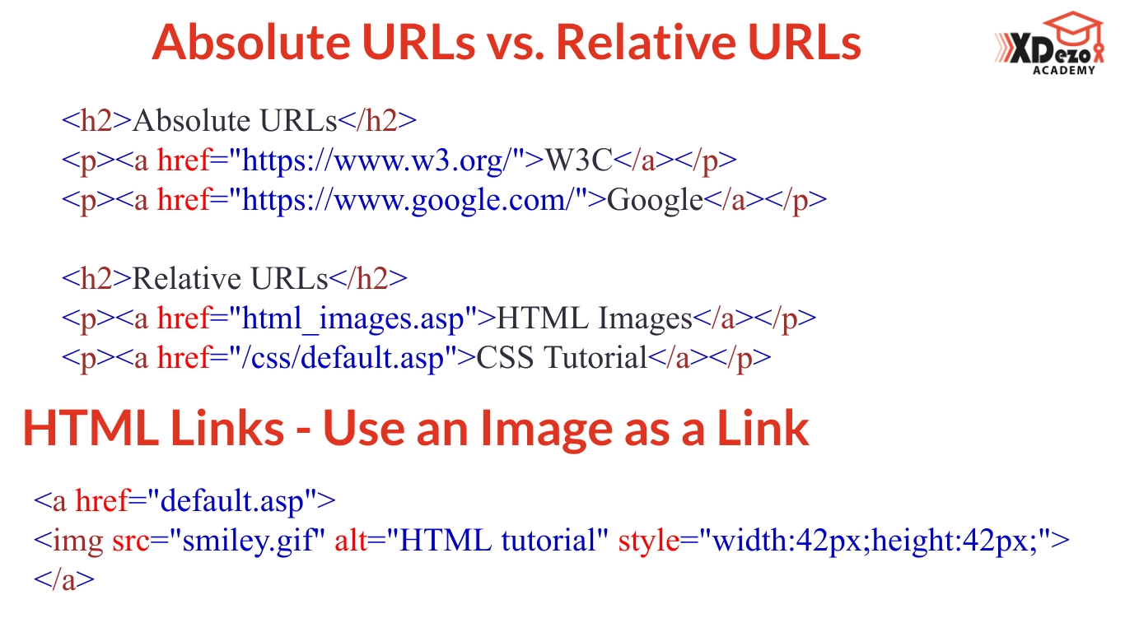

Slide 19
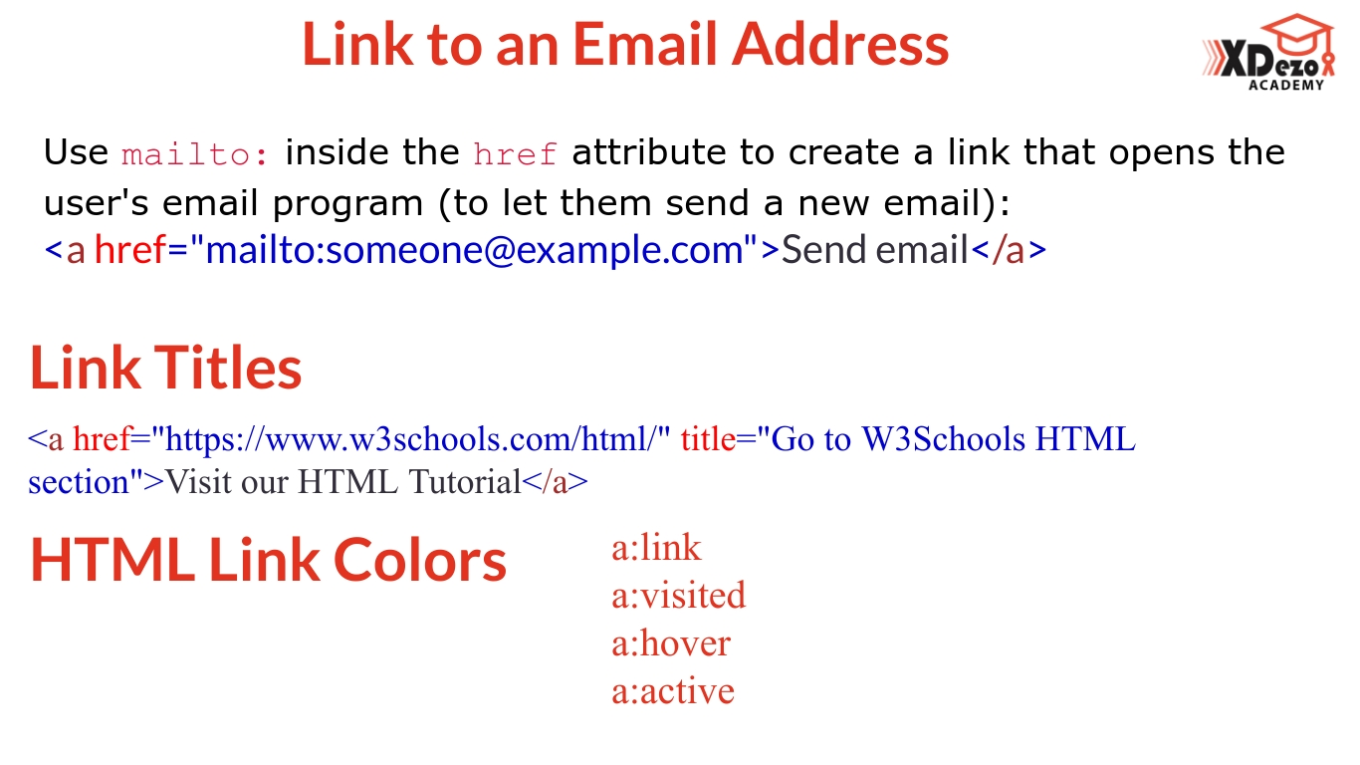

Slide 20
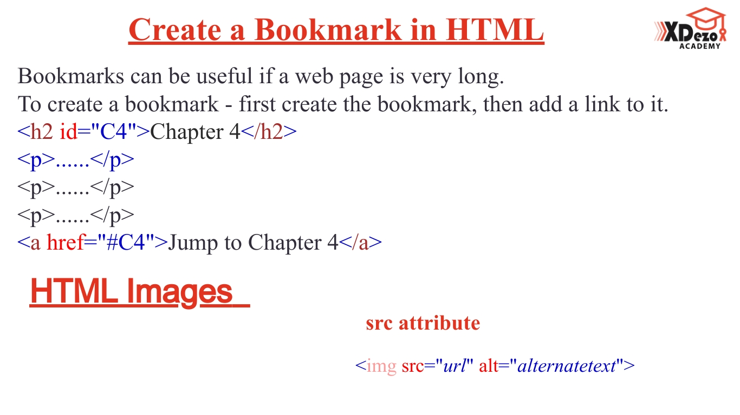

Slide 21
